Slide 1



BLOOD BANK MANAGEMENT SYSTEM USING CLOUD COMPUTING
Under the guidance of
MR. UDDALOK SEN
A Project by
PRIYANK BHATTACHARYYA
ADITYA JHA
RANIT PAL
GOURAV THAKUR

Slide 2
Blood Bank Management System using Cloud Computing, is built to serve those in need of blood. It manages and maintains the record of all the blood donors across the globe and delivers to the recipient in time of need.
Individuals, NGOs, Hospitals can enroll themselves for donation and anyone in need of blood could get in touch easily through our website.
This web application has been made with a user friendly interface, so that anyone can use it and as a security we have provided admin username and password.
Introduction

Slide 3
Problem Statement
After spending several weeks on research, it came to our knowledge about this problem related to blood transfusion that exits in the world today.
In times of emergencies, when a person is suffering from shortage of blood, they are not able to find their donor or blood is not available in blood bank.
Considering this problem, we have decided to build a web application that will connect these peoples to their donors.
This has been made possible by modern computing technologies such as Cloud Computing. We have built a web application and have deployed in Cloud Computing giant, AWS.
With the help of internet, anyone can access our web portal. This is our effort to minimize this problem and make sure nobody suffers due to lack of blood.

Slide 4
Features of the project
The aim of this project is to maintain records of donors across the globe and allow recipients to easily find their donors
The purpose of the project is to ease the daily and regular processes of blood donation and transfusion and convert it into an automated computerized retrievable process. Our main motive is to provide solution for all the blood donation systems across the globe and manage their work using computerized process.
Our project maintains a centralized Database that provides information of donors to the people who needs them.
Our project is running with the help of Amazon Web Services, with the help of which our users can access our website. Our website is accessible anywhere in the world, and multiple users can access the website at the same time.

Slide 5
Overview of the work done
Our project has two fundamental parts, the web application and the cloud server. There are three tiers to the web application namely, the front end, the back end and the middleware.
The front end has been designed using NodeJS, React, HTML and CSS. React components including HTML and CSS with help of NodeJS modules constitute the main framework for the front end.
In the middleware part, with the help of Express server, we are able to connect the front end with the database server. The MongoDB database server helps us to store the user data.

Slide 6
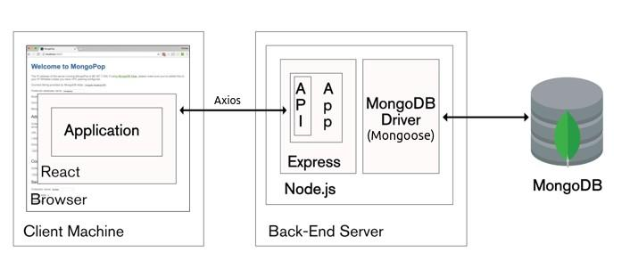
Project Architecture (Web Application)
This project is based on MERN(MongoDB, Express, React, Nodejs) architecture. for the front end, we have used JavaScript, CSS and HTML, inside react components. React-Router-Dom is helping us to create routes and navigate to different pages in website. express server is the middleware connecting the front-end with the MongoDB database. any request from front end is sent to the express server using Axios package. express is sending the request to perform different query operations in the database server with the help of mongoose and returning the data that the user has asked for.

Slide 7
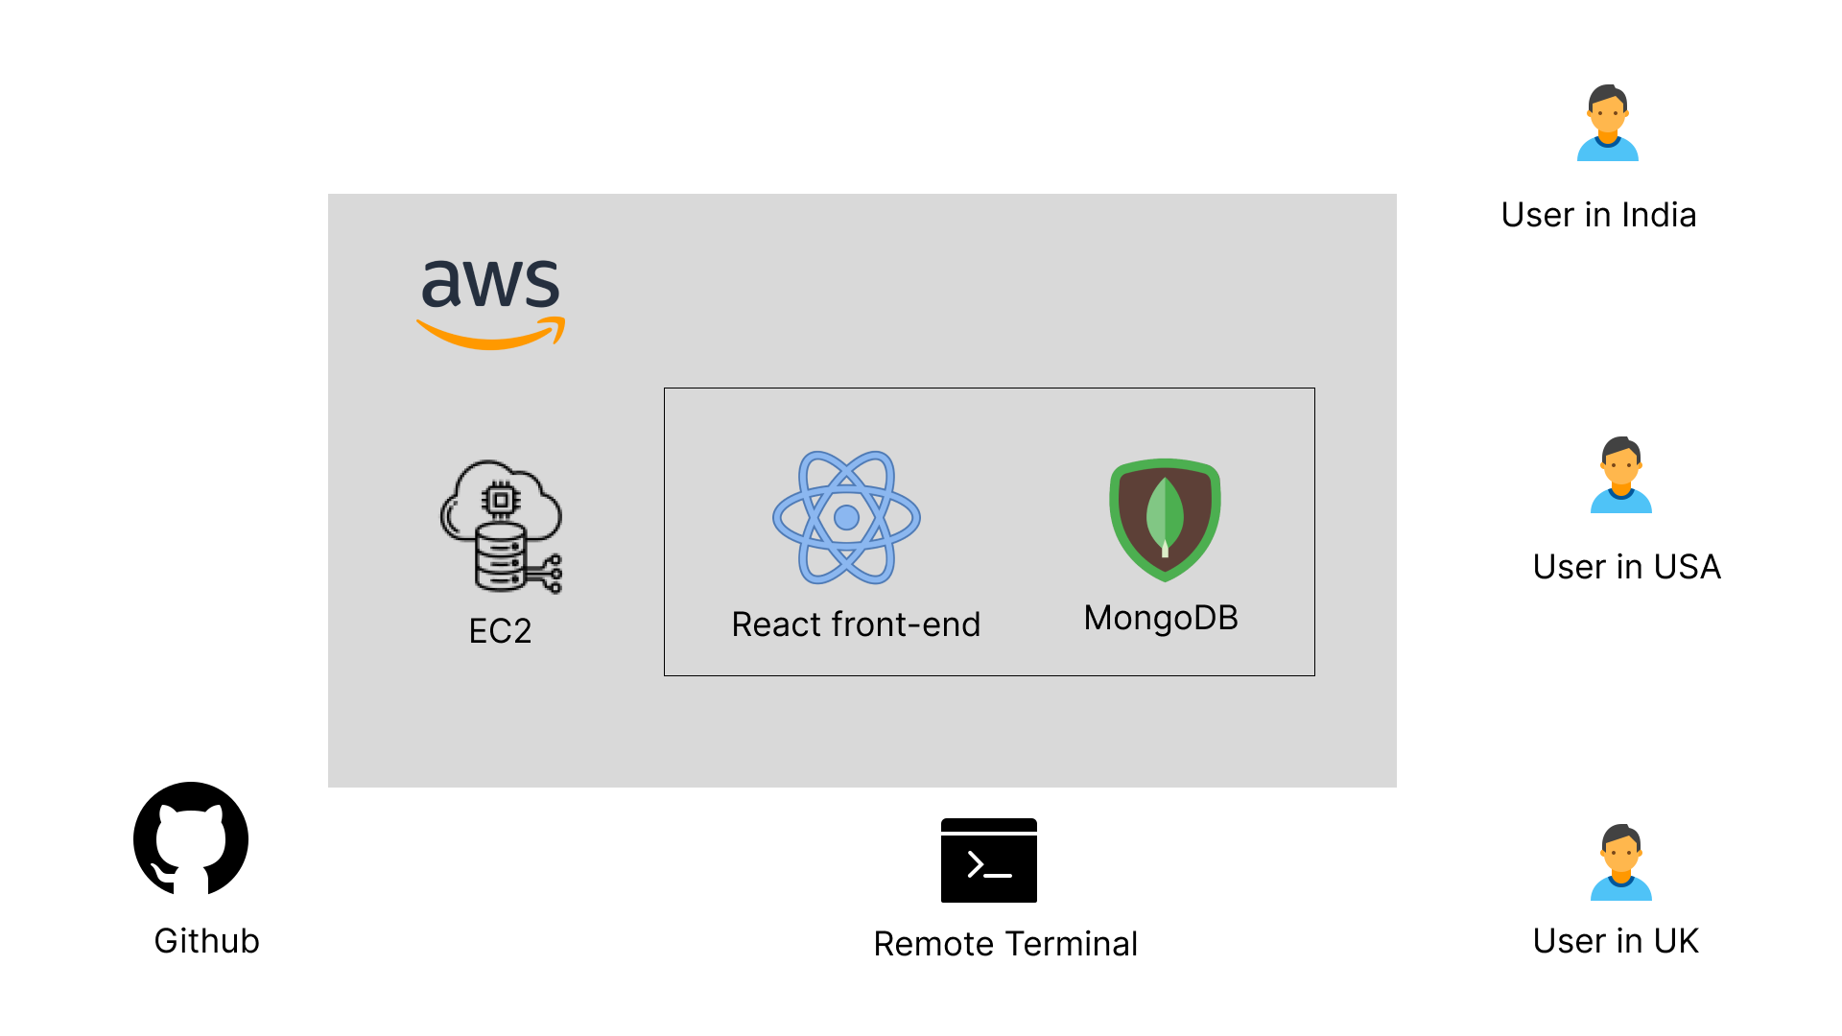

Project Architecture (Cloud Architecture)
Push code
Remote developer start sever

Slide 8
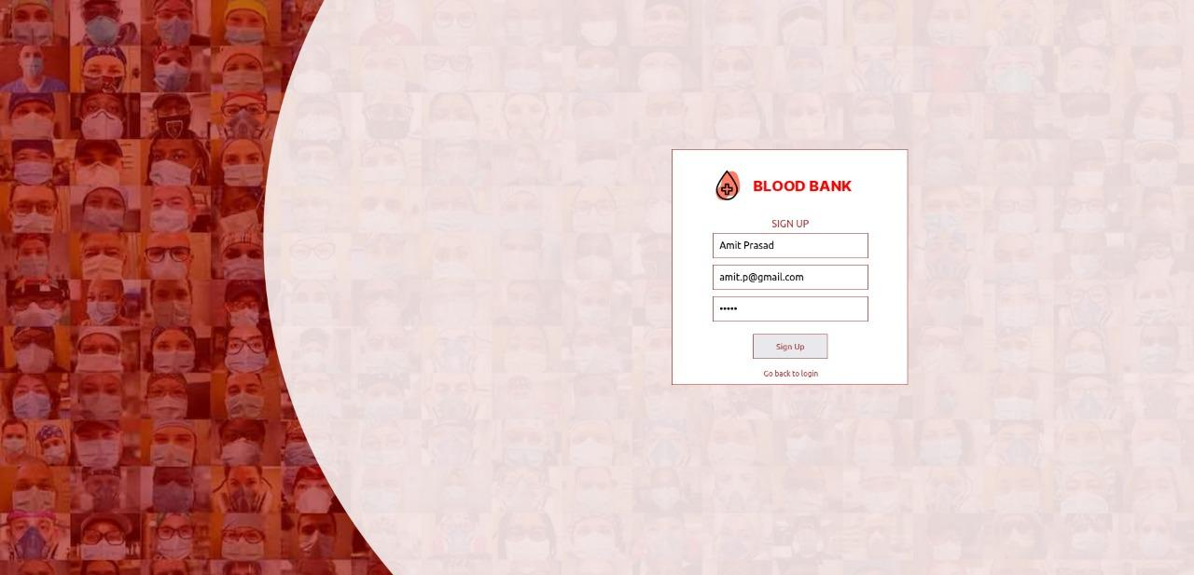
HOW IT WORKS
IF THE USER DOESN'T HAVE AN ACCOUNT THEN HE/SHE CAN SIGN UP AND CREATE IT EASILY.
UNIQUE EMAILS ARE REQUIRED, SO THAT ONE SINGLE USER CAN'T HAVE MULTIPLE ACCOUNTS.
OUR SYSTEM CAN DETECT ,IF EXISTING EMAILS ARE USED AND SHOWS ERRORS IN THAT CASE.

Slide 9
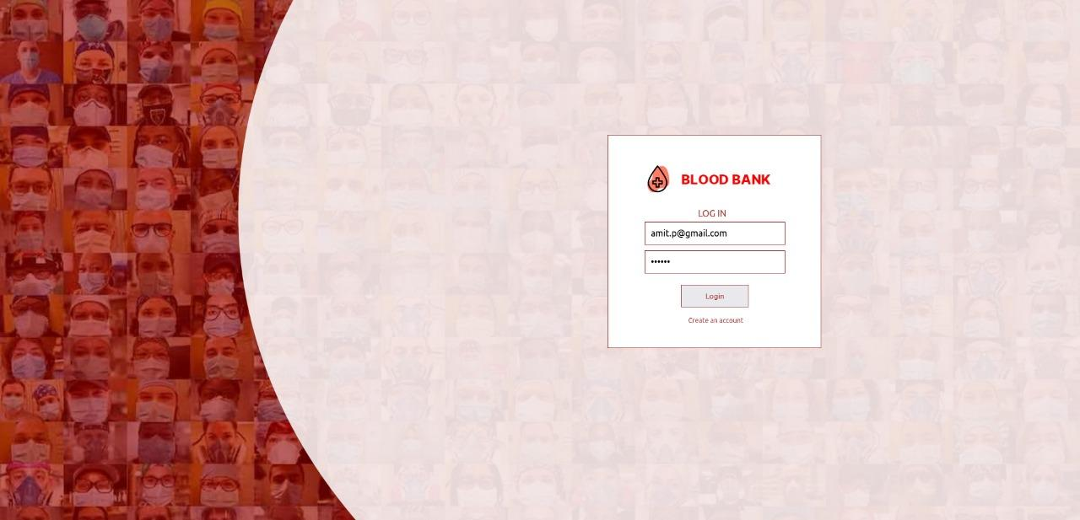
USERS CAN EASILY LOGIN USING THEIR CREDENTIALS.
SYSTEM WILL SHOW ERROR, IF USERNAME OR PASSWORD IS INCORRECT.

Slide 10
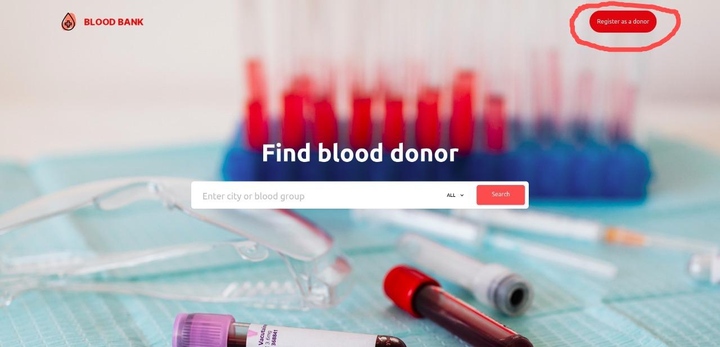
DONORS CAN CLICK ON THIS BUTTON TO REGISTER AS A DONOR.

Slide 11
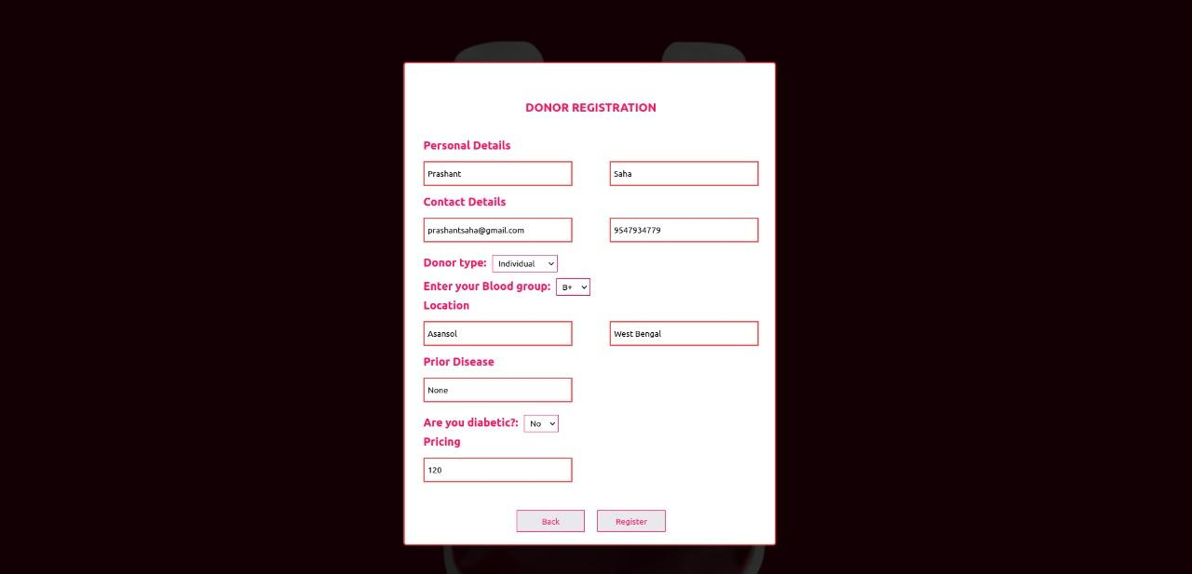
DONORS HAVE TO FILL THIS FORM TO REGISTER SUCCESSFULLY.

Slide 12
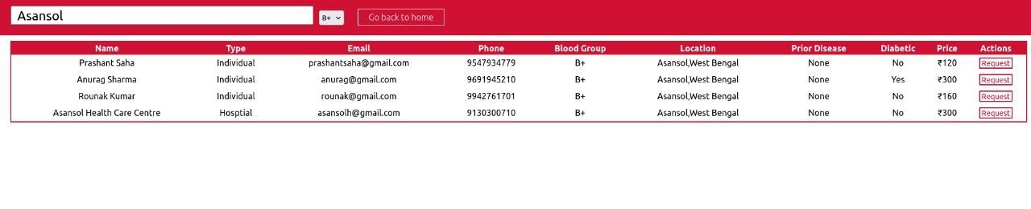
OUR SYSTEMS WILL DISPLAY ALL THE AVAILABLE DONORS ACCORDING TO THE USER’S PREFERENCES.

Slide 13
Conclusion
After extreme hard work and effort over these last few months, our team has reached a point in this project where all the features like donor registration system, donor database management system, user authentication and login system, user searching and request systems, etc. are fully functional and operable. The project has been deployed in Amazon Web Services, and anyone from anywhere in the world can access our website. But, we are constantly looking for scopes to improve the project and constantly rectifying any errors or bugs that exist in the project.
Our website is running in http://54.184.111.82/ and anyone around the globe can access it.

Slide 14

THANK YOU!!!

